Slide 1
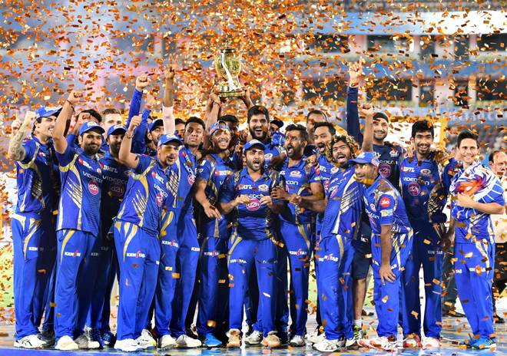
EDA of IPL Matches

Slide 2
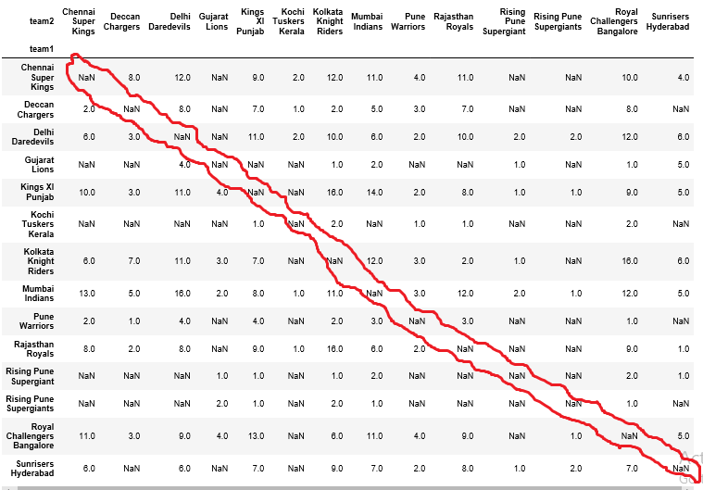
Number of the matches for each team played with other during all season matches?
1. Team 'Kolkata Knight Riders' has played 16 matches (maximum) with teams 'Rajasthan Royals' and 'Kings XI Punjab‘.
2. Team 'Mumbai Indians' and team 'Rajasthan Royals' and 'Delhi Daredevils' have played 16 matches (max) with each other.

Slide 3
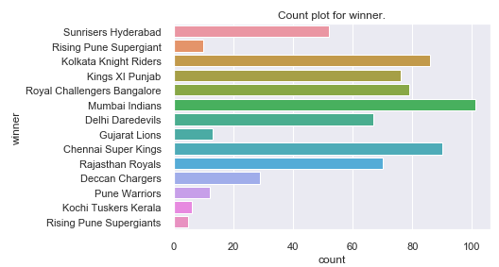
Which team has won how many times during all IPL seasons?
We would say 'Mumbai Indians' have won maximum number of matches during all seasons of IPL matches.

Slide 4
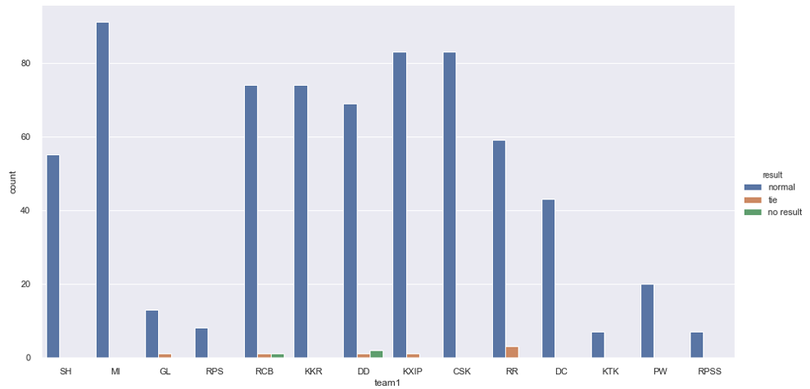
Which team have played maximum number of matches which were not completed or tied?
1. Team 'Delhi Daredevils' have played maximum number of matches which were not completed.
2. Team 'Rajasthan Royals' have played maximum number of matches which were tied.

Slide 5
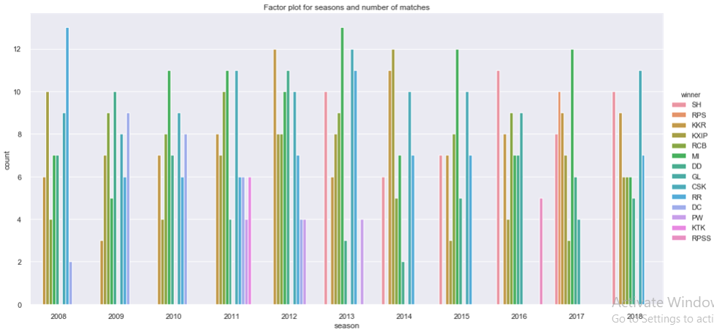
Which team has won what number of matches and maximum number of matches in all seasons?
1. We can say in season 2008 Rajasthan Royals have won maximum number of matches.
2. In season 2018 Chennai Super Kings has won maximum number of matches.

Slide 6
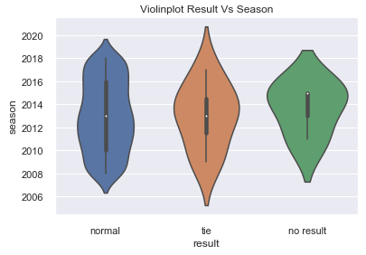
Which seasons were most affected with tied and no result matches?
1. By looking into 'tie result' result type, Season 2014 was much affected with maximum number of tied matches.
2. By looking into 'normal' and 'no result' result type violin plot, Season 2015 was more affected with no result matches.

Slide 7
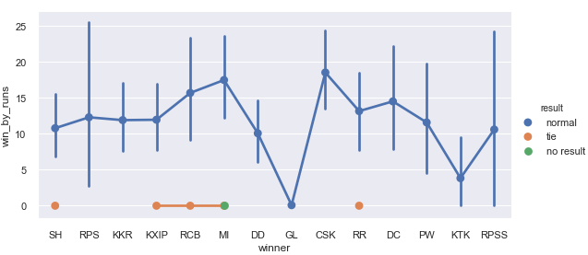
Which team have won the match with maximum margin of runs?
From above plotting its clear that Chennai Supper Kings have won match with maximum margin of runs.

Slide 8
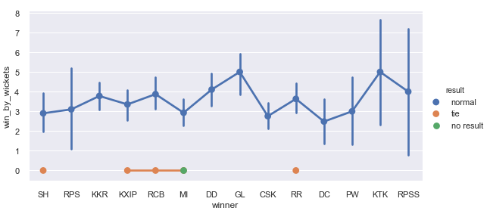
which team have won the match with maximum margin of wickets?
From above plotting its clear that Kochi Tuskers Kerala and Gujarat Lions have won matches with maximum margin of wickets(5 wickets).

Slide 9
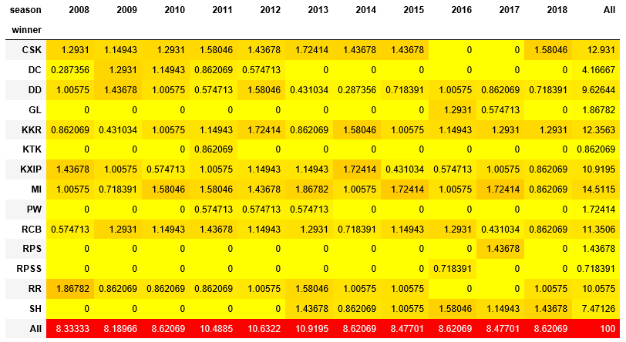
Percentage of each teams winning in each season?
1. From above plot we can easily say that how each team have their winning percentage in each year.
2. We can say that Mumbai Indians have maximum winning percentage with 14.51%
3. At second best winning percentage is for Chennai Super Kings with approx 13%

